Slide 1
Planar Graphs

Slide 2
Planar Graphs
Is it possible to join the three houses to the three utilities in such a way that none of the connections cross?

Slide 3
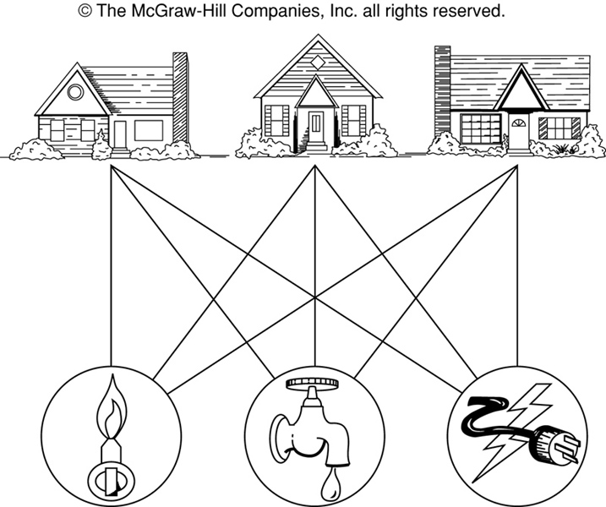
The House-and-Utilities Problem

Slide 4
Planar Graphs
Phrased another way, this question is equivalent to: Given the complete bipartite graph K_{3,3}, can K_{3,3} be drawn in the plane so that no two of its edges cross?
K_{3,3}

Slide 5
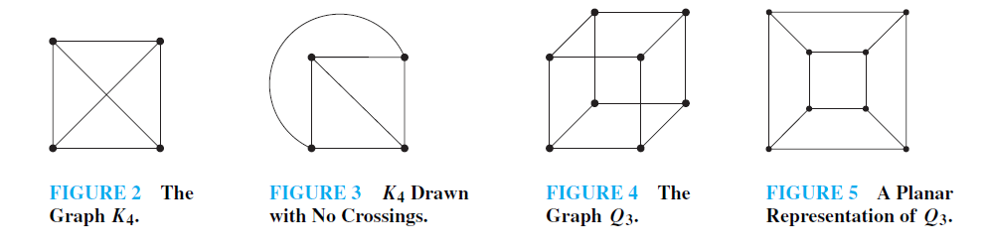

Slide 6
Planar Graphs
A graph is called planar if it can be drawn in the plane without any edges crossing.
A crossing of edges is the intersection of the lines or arcs representing them at a point other than their common endpoint.
Such a drawing is called a planar representation of the graph.

Slide 7
Example
A graph may be planar even if it is usually drawn with crossings, since it may be possible to draw it in another way without crossings.

Slide 8
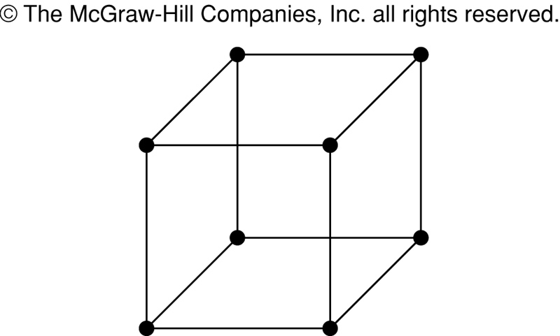
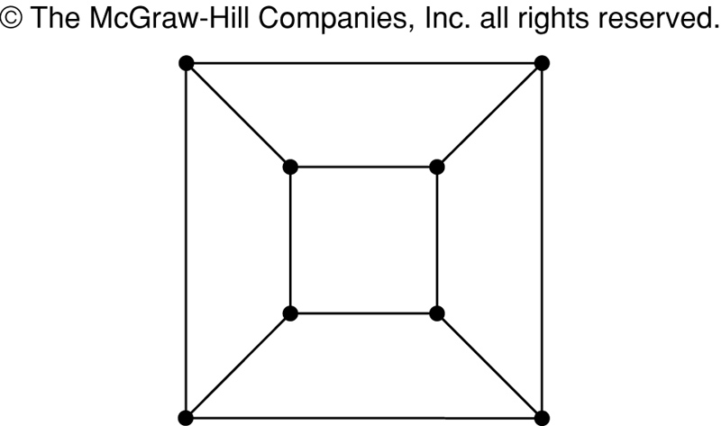
Example
A graph may be planar even if it represents a 3-dimensional object.

Slide 9
Planar Graphs
We can prove that a particular graph is planar by showing how it can be drawn without any crossings.
However, not all graphs are planar.
It may be difficult to show that a graph is nonplanar. We would have to show that there is no way to draw the graph without any edges crossing.

Slide 10
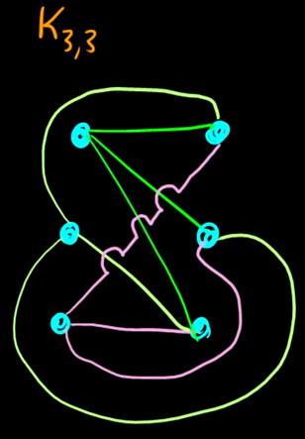

Slide 11
Regions
Euler showed that all planar representations of a graph split the plane into the same number of regions, including an unbounded region.
R₄ R₃ R₂
R₁

Slide 12
Regions
Euler devised a formula for expressing the relationship between the number of vertices, edges, and regions of a planar graph.
These may help us determine if a graph can be planar or not.

Slide 13
Euler’s Formula
Let G be a connected planar simple graph with e edges and v vertices. Let r be the number of regions in a planar representation of G. Then r = e - v + 2.
R₄ R₃ R₂
R₁
# of edges, e = 6
# of vertices, v = 4
# of regions, r = e - v + 2 = 4

Slide 14
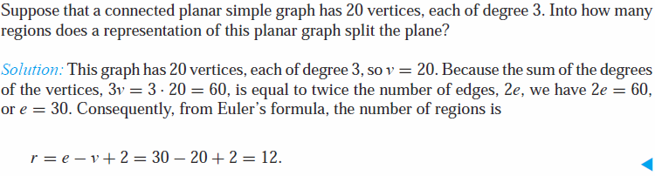
Euler’s Formula Example
r = e - v + 2

Slide 15
Euler’s Formula (Cont.)
r = e - v + 2
Corollary 1: If G is a connected planar simple graph with e edges and v vertices where v ≥ 3, then e ≤ 3v - 6. (no proof)
Is K₅ planar?
K₅

Slide 16
Euler’s Formula (Cont.)
Corollary 1: e ≤ 3v – 6
K₅ has 5 vertices and 10 edges.
We see that v ≥ 3.
So, if K₅ is planar, it must be true that e ≤ 3v – 6.
3v – 6 = 3*5 – 6 = 15 – 6 = 9.
So e must be ≤ 9.
But e = (n choose 2) = n(n-1)/2 = 5*4/2 = 10.
So, K₅ is nonplanar.
K₅

Slide 17
Euler’s Formula (Cont.)
Corollary 2: If G is a connected planar simple graph, then G must have a vertex of degree not exceeding 5.
If G has one or two vertices, it is true;
thus, we assume that G has at least three vertices.
If the degree of each vertex were at least 6, then by Handshaking Theorem,
2e ≥ 6v, i.e., e ≥ 3v,
but this contradicts the inequality from
Corollary 1: e ≤ 3v – 6.

Slide 18
Euler’s Formula (Cont.)
Corollary 3: If a connected planar simple graph has e edges and v vertices with v ≥ 3 and no circuits of length 3, then e ≤ 2v - 4. (no proof)
Is K_{3,3} planar?

Slide 19
Euler’s Formula (Cont.)
K_{3,3} has 6 vertices and 9 edges.
Obviously, v ≥ 3 and there are no circuits of length 3.
If K_{3,3} were planar, then e ≤ 2v – 4 would have to be true.
2v – 4 = 2*6 – 4 = 8
So e must be ≤ 8.
But e = 9.
So K_{3,3} is nonplanar.
K_{3,3}

Slide 20
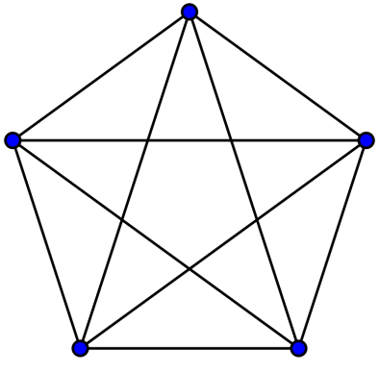
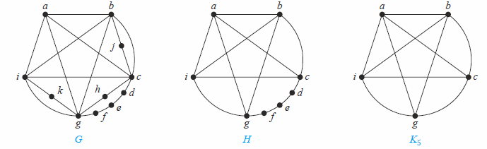
Kuratowski Theorem
A graph is nonplanar if and only if it contains a subgraph homeomorphic to K_{3,3} or K₅.
The intuition: homeomorphism is like graph isomorphism after ignoring some of degree 2 nodes. Example: after ignoring nodes d, e, f in graph H, H is isomorphic to K₅.

Slide 21
If a graph is planar, so will be any graph obtained by removing an edge {u, v} and
adding a new vertex w together with edges {u,w} and {w, v}. Such an operation is called an elementary subdivision.
The graphs G1 = (V1,E1) and G2 = (V2,E2) are called homeomorphic if they can be obtained from the same graph by a sequence of elementary subdivisions.
We have seen that K3,3 and K5 are not planar. Clearly, a graph is not planar if it contains either of these two graphs as a subgraph.
Surprisingly, all nonplanar graphs must contain a subgraph that can be obtained from K3,3 or K5 using certain permitted operations.

Slide 22
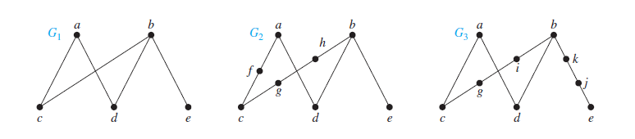
Show that the graphs G1, G2, and G3 displayed in Figure are all homeomorphic.
These three graphs are homeomorphic because all three can be obtained from G1 by
elementary subdivisions. G1 can be obtained from itself by an empty sequence of elementary
subdivisions.
To obtain G2 from G1 we can use this sequence of elementary subdivisions:
(i ) remove the edge {a, c}, add the vertex f , and add the edges {a, f } and {f, c};
(ii ) remove the edge {b, c}, add the vertex g, and add the edges {b, g} and {g, c}; and
(iii ) remove the edge {b, g}, add the vertex h, and add the edges {g, h} and {b, h}.We leave it to the reader to determine the sequence of elementary subdivisions needed to obtain G3 from G1.

Slide 23
G has a subgraph H homeomorphic to K5.
H is obtained by deleting h, j , and k and all edges incident with these vertices.
H is homeomorphic to K5 because it can be obtained from K5 (with vertices a, b, c, g, and i) by a sequence of elementary subdivisions, adding the vertices d, e, and f .
(The reader should construct such a sequence of elementary subdivisions.) Hence, G is nonplanar.

Slide 24
Theorem. Graph K_{3,3} is nonplanar.
Proof. In any planar representation of K_{3,3}, vertex v₁ must be connected to both v₄ and v₅, and v₂ also must be connected to both v₄ and v₅.
v₁ v₂ v₃
v₄ v₅ v₆

Slide 25
Regions
The four edges {v₁, v₄}, {v₄, v₂}, {v₂, v₅}, {v₅, v₁} form a closed curve that splits the plane into two regions, R₁ and R₂.
v₁ v₂ v₃
v₄ v₅ v₆
v₁ v₅
R₂ R₁
v₄ v₂

Slide 26
Regions
Next, we note that v₃ must be in either R₁ or R₂.
Assume v₃ is in R₂. Then the edges {v₃, v₄} and {v₄, v₅} separate R₂ into two subregions, R₂₁ and R₂₂.
v₁ v₅ v₁ v₅
R₂₁
R₂ R₁ → v₃
R₂₂
v₄ v₂ v₄ v₂

Slide 27
Regions
Now there is no way to place vertex v₆ without forcing a crossing:
If v₆ is in R₁ then {v₆, v₃} must cross an edge
If v₆ is in R₂₁ then {v₆, v₂} must cross an edge
If v₆ is in R₂₂ then {v₆, v₁} must cross an edge
v₁ v₅
R₂₁
v₃ R₁
R₂₂
v₄ v₂

Slide 28
Regions
Alternatively, assume v₃ is in R₁. Then the edges {v₃, v₄} and {v₄, v₅} separate R₁ into two subregions, R₁₁ and R₁₂.
v₁ v₅
R₁₁
R₂ R₁₂ v₃
v₄ v₂

Slide 29
Regions
Now there is no way to place vertex v₆ without forcing a crossing:
If v₆ is in R₂ then {v₆, v₃} must cross an edge
If v₆ is in R₁₁ then {v₆, v₂} must cross an edge
If v₆ is in R₁₂ then {v₆, v₁} must cross an edge
v₁ v₅
R₁₁
R₂ R₁₂ v₃
v₄ v₂

Slide 30
Planar Graphs
Consequently, the graph K_{3,3} must be nonplanar.
K_{3,3}

